Slide 1
Coptic Lesson 8
Coptic Abbreviations

Slide 2
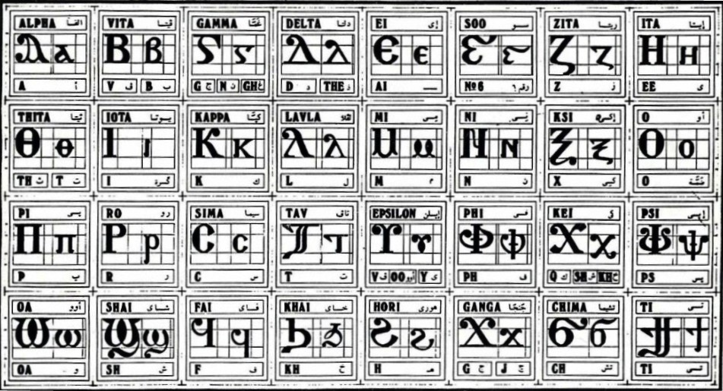
Coptic Alphabets

Slide 3
Alphabet Questions
Coptic
English
Name
'
ps
Epsee
k
k
Kappa
h
h
Horee
d
d, z
Delta
l
L
Lavla
z
z
Zeeta
u
oo, v, y
Epsilon

Slide 4
Rule for the Delta D
d
(in names)
D d =
z
(otherwise)
Examples:
doxa
dikeoc
Dauid
dwron
Daniyl
demwn

Slide 5
Rule for the Vita B
v
(before a vowel)
B b =
b
(otherwise, unless in a name)
Examples:
hwb
qybc
Iakwb
baki
nyb
kwbab
tebc
nobi
lobs
,eroubim
niben
noub
`mbon
abwk

Slide 6
Rule for the Ghamma G
e-family:
e> y> i> u
g
(before e-family)
G =
gh
(otherwise)
n
(before g> x> k> ,)
Examples:
genoc
agora
aggeloc
agioc
`gravy
calpigx
gumnacia

Slide 7
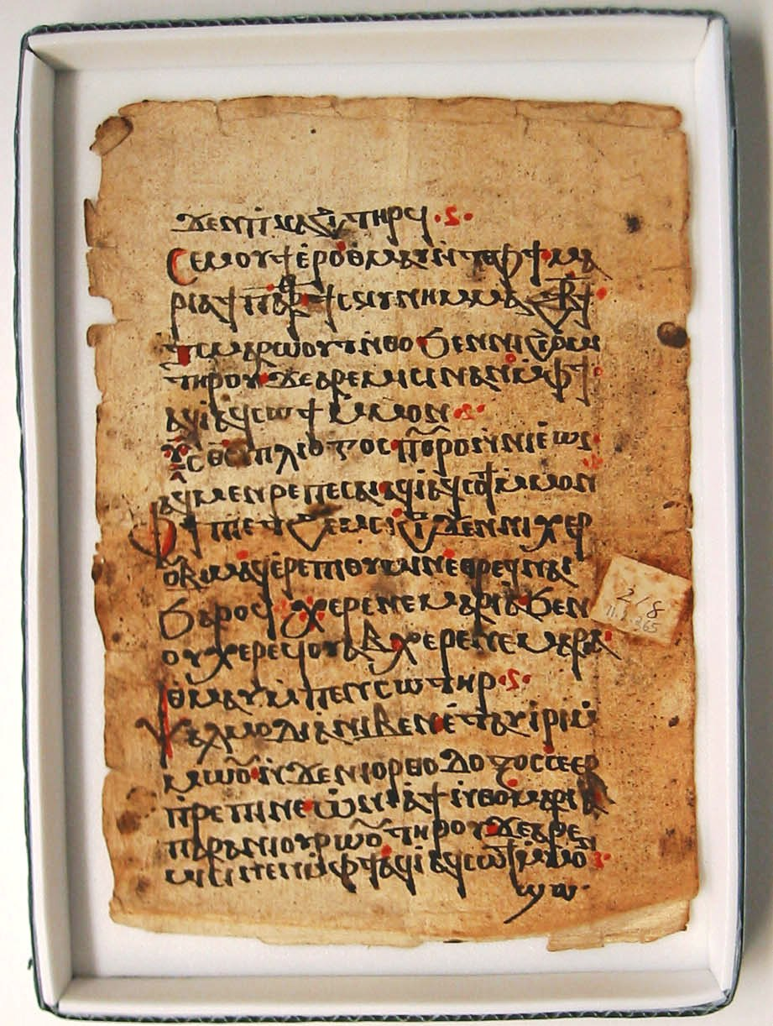
Coptic Manuscript

Slide 8
Coptic Abbreviations – Part 1
Abbreviation
Long Form
Meaning
V]
```Vnou]
God
¡
[oic
Lord
Pen¡
Pen[oic
Our Lord
I=y=c
Iycouc
Jesus
P=,=c
Pi`,rictoc
The Christ
=,=c
,rictoc
Christ
=p=n=a
`pneuma
Spirit

Slide 9
Coptic Abbreviations – Part 2
Abbreviation
Long Form
Meaning
Pi=p=n=u
Pi`pnema
The Spirit
=e=;=u
`e;ouab
Holy
=c=w=r
cwtyr
Savior
I=l=y=m
Ieroucalym
Jerusalem
I=c=l
Icrayl
Israel
=p=;=r
Par;enoc
Virgin
K=e
Kuri`e `ele`ycon
Lord have mercy (Gk)

Slide 10
Coptic Abbreviations – Part 3
Abbreviation
Long Form
Meaning
¢
marteroc
Martyr
¾
`ctauroc
Cross
`P¡
`P[oic
The Lord
=a=l
Allyloui`a
Rejoice
=u=c
Uioc
Son (Gk)
==;=c
:eoc
God (Gk)
=,=e
,ere
Greetings

Slide 11
Coptic Abbreviations Exercise
Pen¡ I=y=c P=,=c
Pi=,=c Pen=c=w=r
Pi=p=n=a =e=;=u
}=p=;=r =e=;=u Mari`a
Pen¡ ouoh Pen=c=w=r
Pa¡ I=y=c Pi=,=c pa=c=w=r `naga;oc
=u=c =;=c

Slide 12
Announcement
Please finish your take-home exercises.

Slide 13

Oujai qen `P[oic

